Slide 1

The peacock
Author: Jeyaseelan

Slide 2
General Information Scientific name: Pavo cristatus Family: Phasianidae (same family as pheasants) Native range: Indian subcontinent — found across India, Sri Lanka, and parts of Myanmar. National bird of India: Symbolizes grace, pride, and beauty.
- Neil Armstrong

Slide 3
Natural Habitat Prefers open forests, farmlands, and grasslands near water sources. Commonly seen in semi‑dry regions and village outskirts where food and shelter are abundant. Roosts on tall trees at night to stay safe from predators.
- Neil Armstrong

Slide 4
Food Habits Peacocks are omnivorous: • Plant-based: Seeds, grains, fruits, berries, and tender shoots. • Animal-based: Insects, small reptiles, frogs, and even snakes. • They help control pests in agricultural areas — a natural benefit to farmers.
- Neil Armstrong

Slide 5
Male peacock: Brilliant metallic blue and green plumage, long iridescent tail feathers (“train”) with eye‑like patterns.
- Neil Armstrong

Slide 6
Female(peahen) Brownish‑grey with green neck feathers; lacks the long train.
- Neil Armstrong

Slide 7
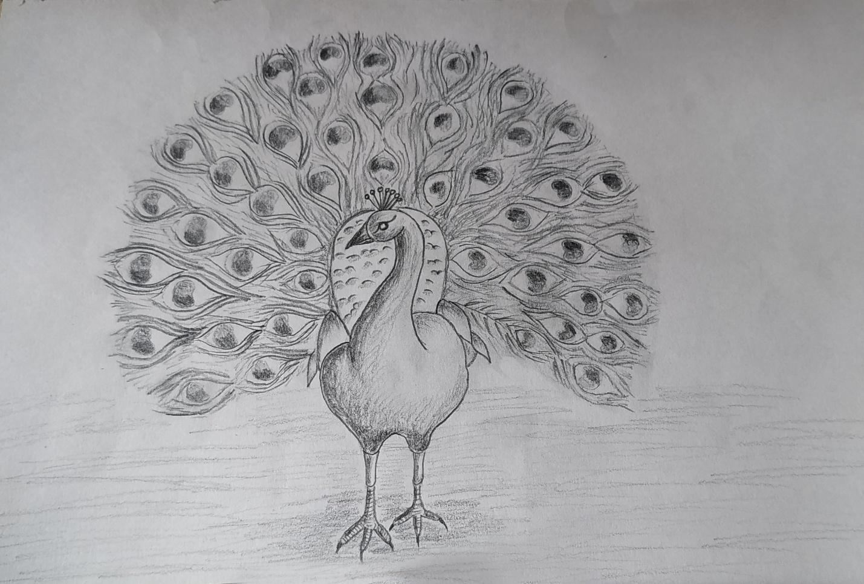
Behavior and Breeding Breeding season: Monsoon months (June–September). Males perform elaborate dances and calls to attract females. Females lay 3–6 eggs in shallow ground nests. Chicks can walk and feed themselves within hours of hatching.
Pencil drawn image
Pencil drawn image

Slide 8
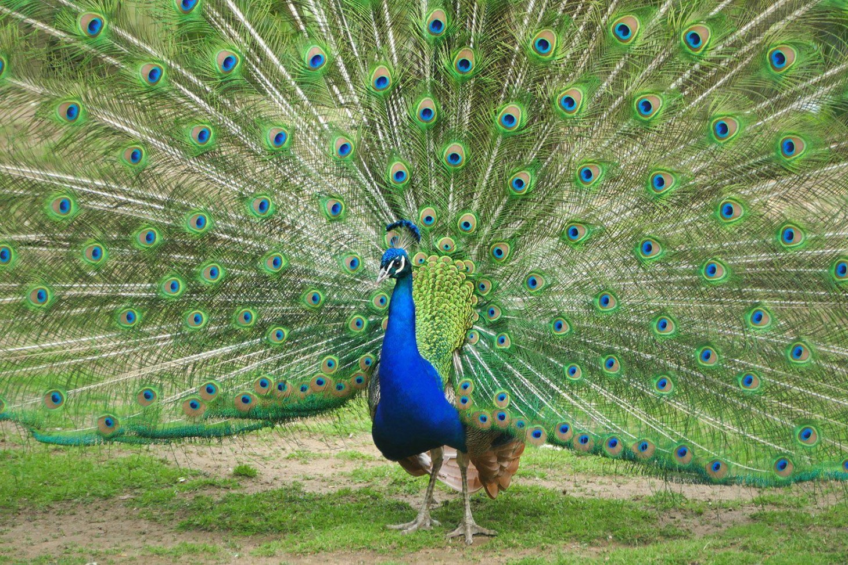
Availability and Conservation Widely distributed across India, Sri Lanka, and introduced in Africa, Australia, and U.S. parks. Protected under Schedule I of the Indian Wildlife Protection Act, 1972. Threats include habitat loss and illegal hunting for feathers, though populations remain stable in many regions.
Right side is the picture of peacock

